Slide 1
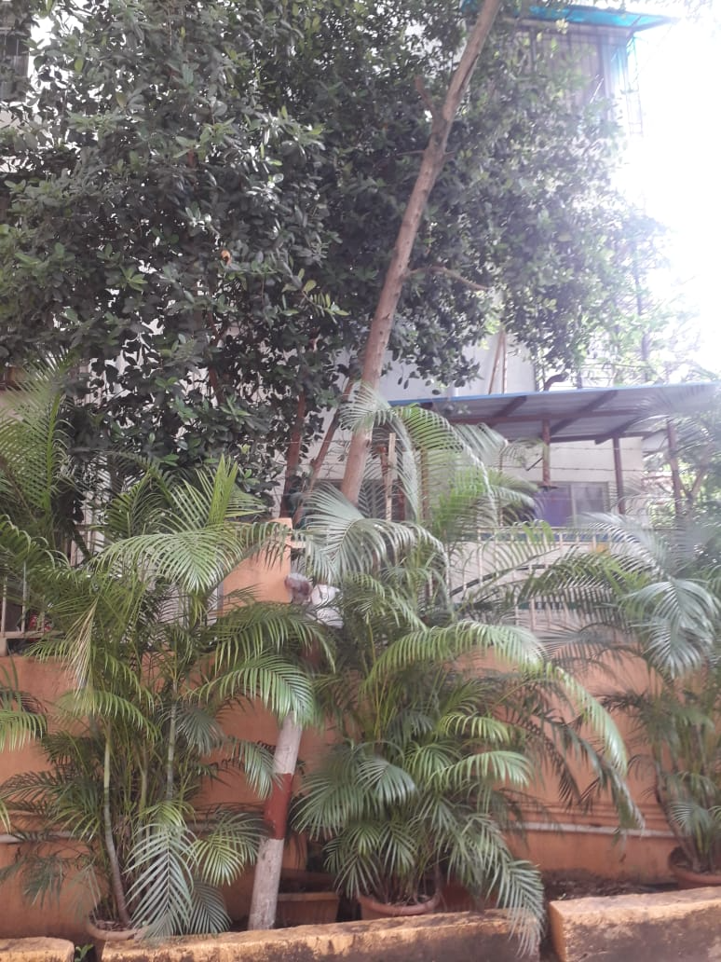
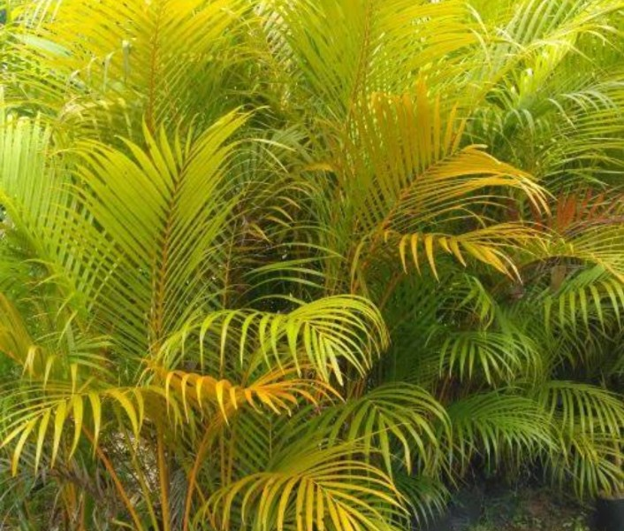
Golden Palm

Slide 2

Common Name : Golden cane palm, Areca palm, Yellow palm, Butterfly palm
Scientific Name : Chrysalidocarpus lutescens
Family : Arecaceae, or Palmae
Habit : prefers average to warm environments and high humidity. It should be given regular misting, especially during the winter if the humidity is exceptionally dry. Keep away from drafts of hot and cold air that can harm the plant.
Distribution : The great centres of palm distribution are in America and in Asia from India to Japan and south to Australia and the islands of the Pacific and Indian oceans, with Africa and Madagascar as a third but much less important palm region.

Slide 3
Description :​
Height of Tree : 30-35 Feet ​
Leaves : The leaves are upward-arching, 2–3 m (6 ft 7 in – 9 ft 10 in) long, pinnate, with a yellow mid-rib. The petiole is yellow-green in colour and waxy in texture, with a maculate base. The leaves have 40-60 pairs of leaflets. Leaflet arrangement is opposite and their shape is linear to lanceolate.​
Flower : The flowers of palm trees grow on an inflorescence
Fruits. :​​ it has an outer edible layer, the mesocarp; then a layer of shell, inedible, and the kernel inside, edible
Bark of the tree : The stems are covered with smooth, golden-yellow or light green colored bark, giving it a vibrant and tropical look. The plant can reach a height of around 6 to 10 feet (1.8 to 3 meters) indoors and can grow much taller outdoors in its native habitats.
Seeds : palm seeds also known as attap seeds. They are the immature fruits of the nipa palm “or mangrove palm”, which grow in soft mud and slow-moving tidal and river wate

Slide 4
USES​ :
Air purification The golden palm is considered one of the best air-purifying plants, removing formaldehyde, xylene, and toluene from the air. It also increases the amount of oxygen in a room. Decorative The golden palm is a popular houseplant in temperate climates and can also be used in outdoor ornamental displays in the summer. It has feathery, arching fronds and warm-colored stems.

Slide 5
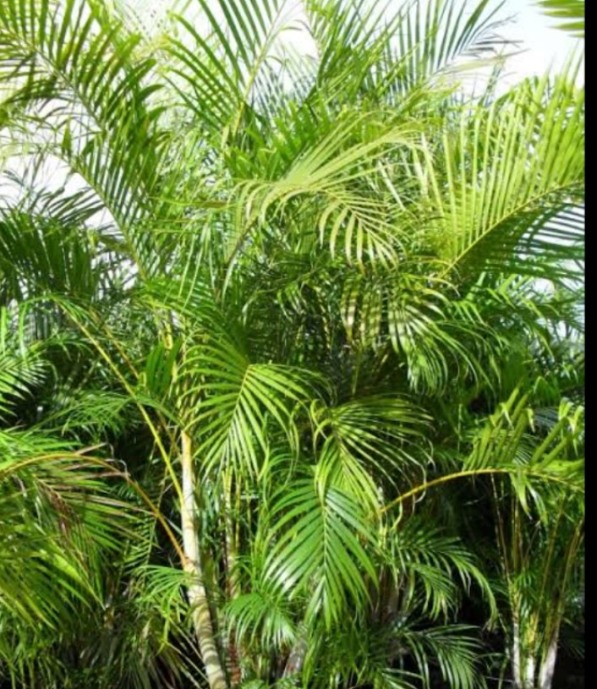
Therapeutic​ Caring for a golden palm can reduce stress and fatigue, and boost mood, productivity, concentration, and creativity. ​ Feng Shui​
According to Vastu and Feng Shui, the golden palm can be placed in the east, southeast, south, or north to bring positivity to a home. ​
Other uses ​
The golden palm’s fiber can be used to make fishing nets. ​
​

